Slide 1
WELCOME
TO OUR PRESENTATION

Slide 2
OUR TEAM
Date: 25-11-24
SUBMITTED BY:
Sheikh Ataharul Islam Labib
ID: 241-15-828
Section: 66-O
Umma Kulsum
ID: 241-15-597
Section: 66-O
Hasibul Hasan
ID: 241-15-424
Section: 66-O
Nishat Tasmin
ID: 241-15-648
Section: 66-O
SUBMITTED TO :
Sadia Anjum Elora
Lecturer , Department of CSE
Daffodil International University

Slide 3
INTRODUCTION
Movie title: The Pursuit of Happyness
Release Year: 2006 ,Director: Gabriele Muccino
Main Cast: Will Smith (Chris Gardner), Jaden Smith (Christopher Gardner), Thandie Newton (Linda)
Genre: Biographical Drama

Slide 4
Plot Summary
The Pursuit of Happyness follows Chris Gardner, a struggling salesman in San Francisco, who battles homelessness and personal struggles to secure a better future for his young son, Christopher. Despite facing adversity, Chris never gives up on his dream of a better life and a stable career, eventually landing a prestigious job as a stockbroker.

Slide 5
Success through hard work
The film explores the notion that anyone, regardless of background or circumstance, can achieve success through hard work and determination.
Perseverance in the Face of Adversity
Fatherhood and Responsibility
Key Themes
Chris faces immense challenges, including homelessness, financial struggles, and the breakdown of his marriage. Yet, he remains resolute in his pursuit of success for the sake of his son.
Chris’s deep love and commitment to his son, Christopher, is a driving force in the story. The relationship between father and son is central to the film’s emotional core.

Slide 6
Key Scene Analysis
The Homeless Shelter Scene
The Interview Scene
The Final Moment
In one of the most emotional scenes, Chris and his son are forced to spend the night in a homeless shelter. The vulnerability and rawness of the moment showcase the severity of their situation and Chris’s determination to protect his son.
Chris attends an interview for a stockbroker position while still struggling with homelessness. His calm demeanor despite his circumstances demonstrates his unyielding commitment to his dream.
In the iconic scene where Chris gets the job offer, the tears of joy represent the culmination of his struggles and sacrifices, symbolizing hope and the reward of perseverance.

Slide 7
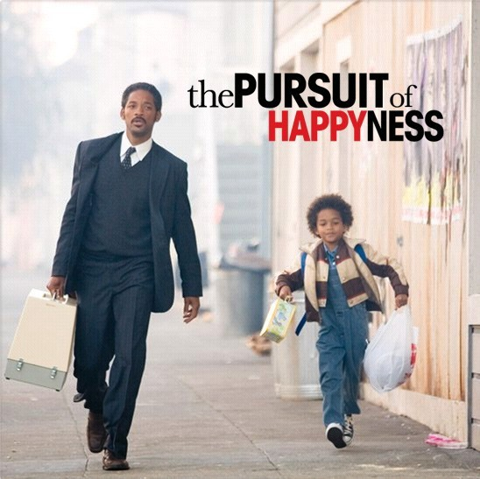
Impactful Moments
Lessons Learned
The film’s portrayal of fatherhood is deeply moving. Chris’s determination to provide for his son, even in the most dire circumstances, is both heartbreaking and inspiring.
Chris’s deep love and commitment to his son, Christopher, is a driving force in the story. The relationship between father and son is central to the film’s emotional core.

Slide 8
The Pursuit of Happyness is a powerful story of resilience, hope, and the American Dream. Chris Gardner’s journey reminds us that success is often a product of hard work, persistence, and love for those we care about.
Conclusion

Slide 9
THANK YOU!

